Slide 1
Renewable and non-renewable sources of energy
Wojciech Regulski

Slide 2
What does „renewable” mean?
A non-renewable resource is a natural resource that cannot be re-made or re-grown at a scale comparable to its consumption.
Renewable resources are natural resources that can be replenished in a short period of time.

Slide 3


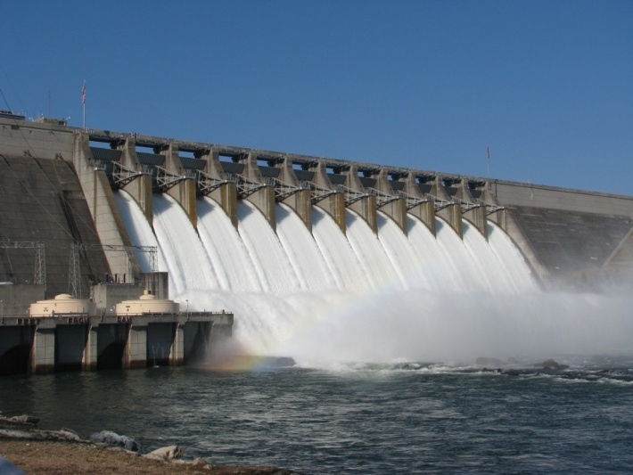
Renewable sources - examples
Solar
Wind
Water
Geothermal
Biomass

Slide 4
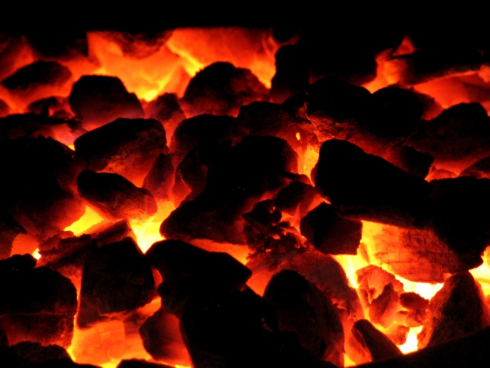
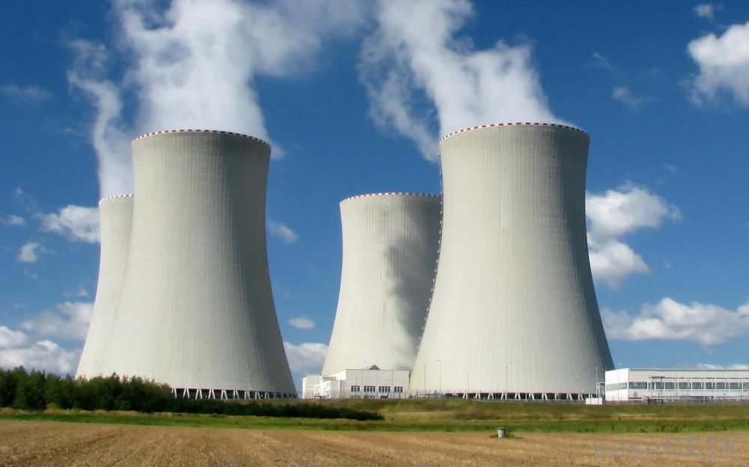
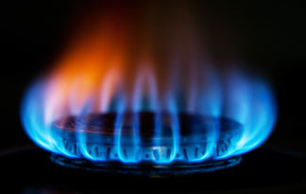
Non-renewable sources - examples
Coal
Oil
Gas
Nuclear

Slide 5
Non-renewable sources - advantages
Independence from the weather - reliability
Cost-effective
Easy to produce and use

Slide 6
Non-renewable sources - disadvantages
Can be depleted
Air pollution which causes health and environmental problems
Vast amount of greenhouse gases
May be the cause of war

Slide 7
Renewable sources - advantages
Can’t be depleted
Everyone can have a small energy plant
Near-zero waste products – less impact on the environment and our health
Can easily provide electricity even on a desert island
Stabilization of global energy prices

Slide 8
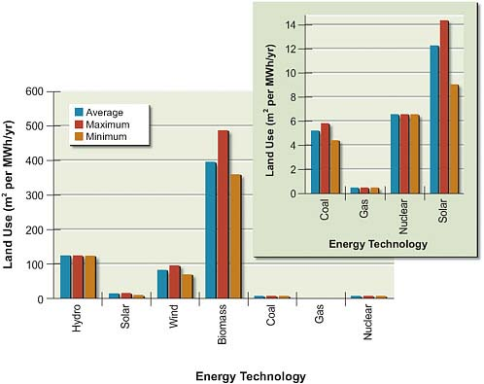
Renewable sources - disadvantages
High land use
Dependence on the weather - unreliability
High initial cost

Slide 9
Summary
Non-renewable sources are cost-effective but destroy environment
Renewable sources are costly, cause many problems in stable production and distribution but don’t harm our health or the environment
Should we stop using non-renewable sources of energy?

